Slide 1



Fastnet Trophy 2026
17th – 19th April

Slide 2
Introductions
OA – Schull Community College Sailing Club
Host – Fastnet Marine Outdoor Education Centre
Personnel
Event Director – Clodagh O’ Driscoll
Race Manager – Dave Harte
Safety Officer – Clinton Copithorne
Designated Liaison Person – Sinéad Scully
AIM – To get as much racing completed as possible for all

Slide 3
Points to note
Official Notice Board – Ksail platform – schedule/SIs/NoR/Amendments Other Documents - Safety Plan/Note to Competitors
NoR/SIs – please read
Boats – TRs
Weather - Wetsuits – Water Temp is 10 degrees
Changing rooms – remove bags from changing rooms – don’t leave valuables in changing rooms
Rigging, recovery and derigging – help required
Red flag and bailer

Slide 4

Points to note
Parking – no parking at SCC (Friday)
Refillable water bottles
WhatsApps Community – QR link
Dinner – 7pm Schull Community College
Lunch
  Provided for volunteers – forms
  Pre – ordered for competitors - €5 per person per day
Merchandise – Event Tshirts - €15 (Cash)
Village/community/volunteers – respect

Slide 5
Schedule Friday 17th April
Registration - 6 -7pm (Thurs)
Registration – 7.30 – 8.30am
Helper/Volunteer Briefing 8.30am
Competitor briefing – 9am
First gun will be no earlier than 9.57 am

Slide 6
Registration
Bring:
Consent forms – cannot sail without a consent form
Team personnel if any changes (advance preferable)
Bibs (identify)- deposit
Fees and damage deposit (make sure they are paid)

Slide 7
Format
Single Change Swiss League
Schedule will be online (Ksail) – screen on pier
Accessible on phones

Slide 8
Changeovers - Essential
Clodagh – overseeing changeovers
Bibs
Smooth change overs essential to the running of the event
Please impress upon your sailors that they need to be close by – if sailors are not there the races will be sailed with out them. (RC)

Slide 9
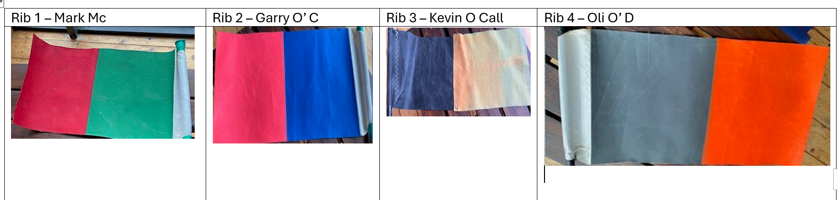

Slide 10
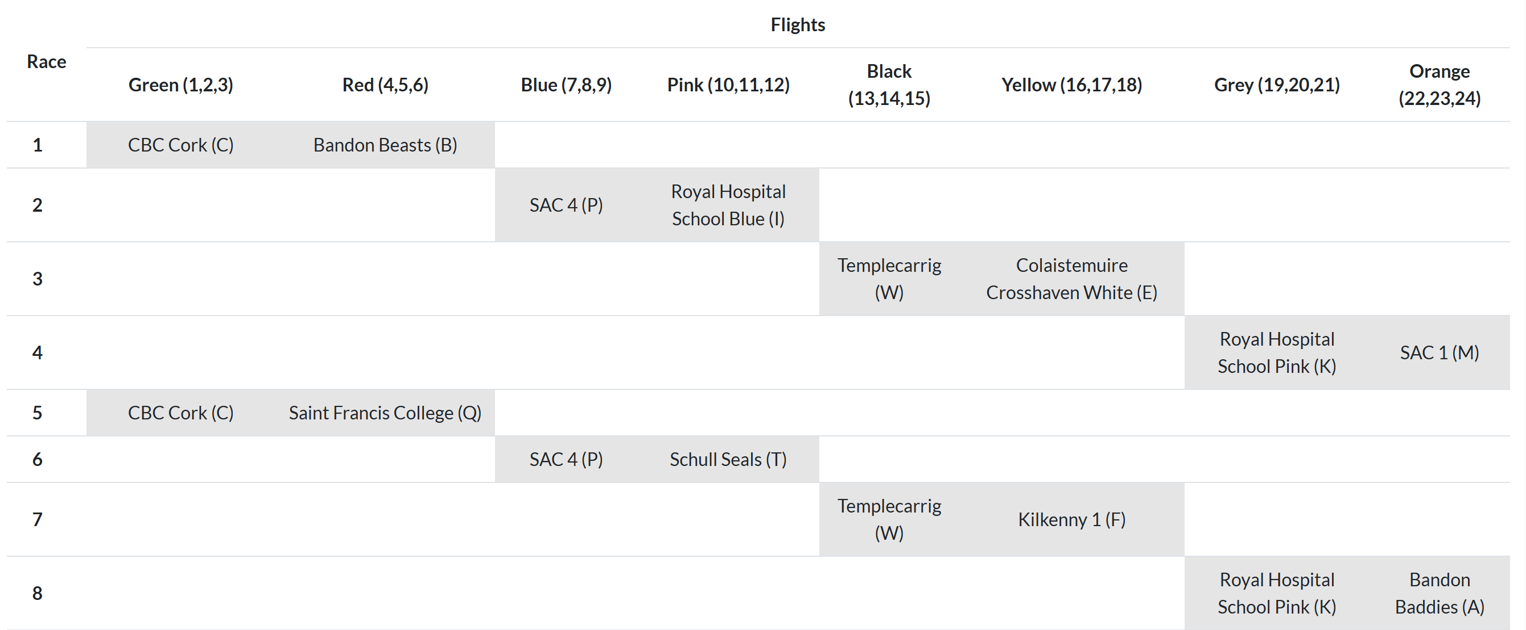






Slide 11
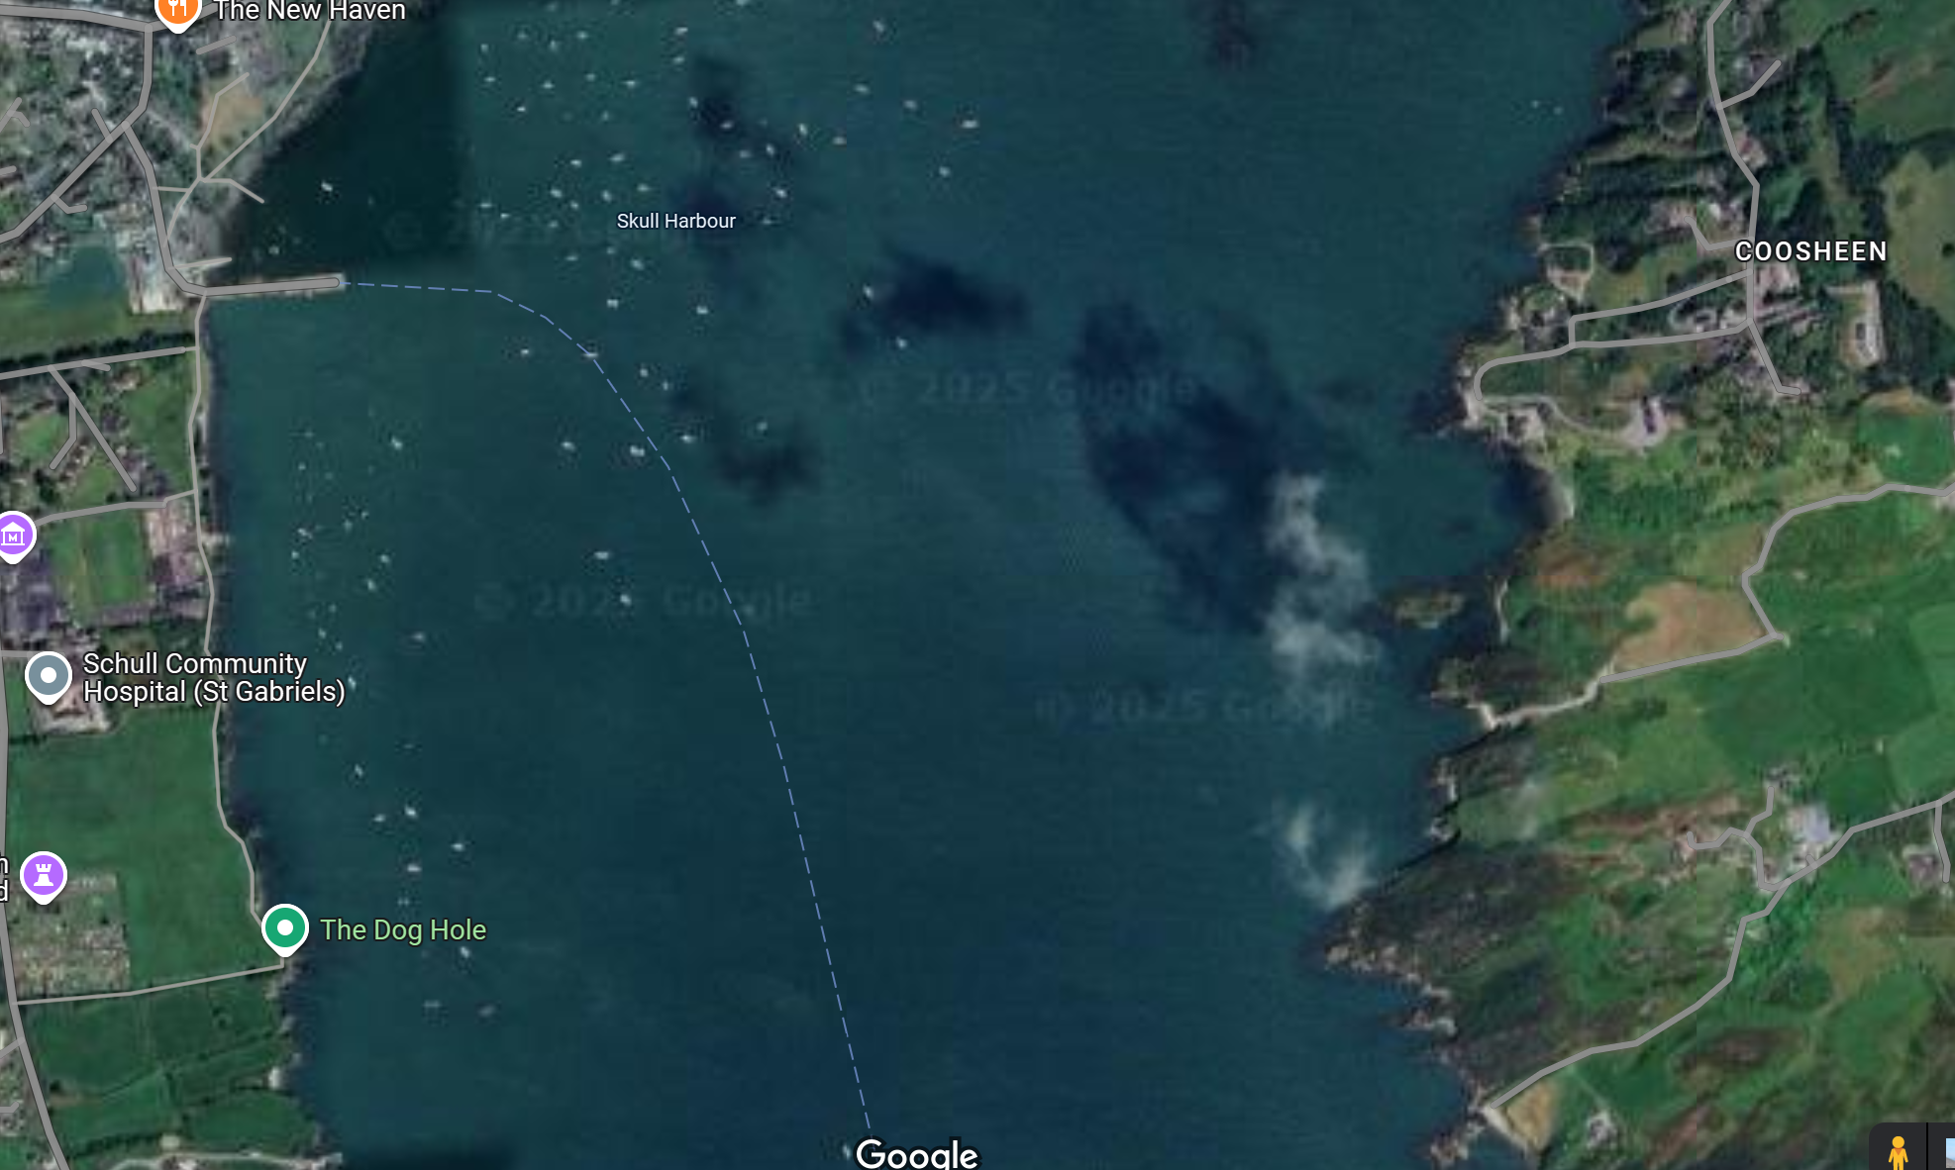





Slide 12
Roles
Thank you all
I don’t have a day to day list yet - I will post this on whatsapp
We may ask people during the event to slot in

Slide 13
Roles
Results – Daniel, Aidan, Trish, Mike, Brendan,, Emily, Mihaela
Start Boat – Clinton, Jenny, Tony, Lathem, Sheenagh, Rena
Finish Boat – Sean, Óisin,
Changeovers – Clodagh, Geraldine H, Mark McC, Kevin O C, Garry O’ C, Oli O’ D, Andy J, Brian L, Robert C, Jammer, Elliot, Sheenagh
Bosun – Luke O’ C/Oran C
Beachmaster (Launching) – Luke O Connor

Slide 14
Safety
Clinton is Event Safety Lead
All boats regardless of duties/roles are safety boats and if an issue arises will revert to this.
Every rib will have a vhf – can be signed out with Sinéad in the morning and please return to her.
VHF Channel 74 will be used
First Aid – Luke O’ C/Robert C/Sinéad, Mark McCarthy, Sheenagh Mac Namara

Slide 15
Any questions?

